Slide 1
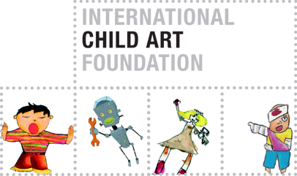
Children’s Resilience and Natural Disasters
Visual Markings of Recovery and Hope

Slide 2
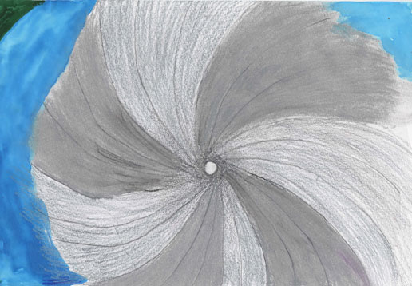
On August 29-30, 2005, Hurricane Katrina struck the U.S. Gulf Coast

Slide 3
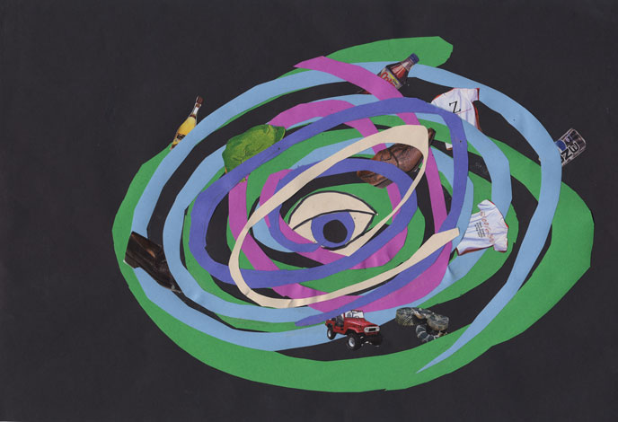
1,836 people were killed and more than $80 billion in damage resulted

Slide 4
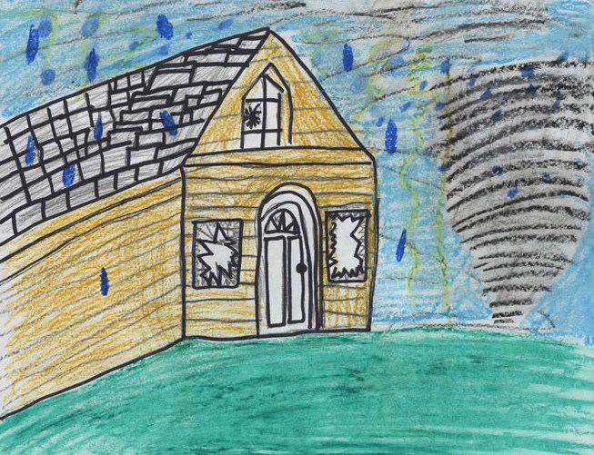
Homes were destroyed

Slide 5
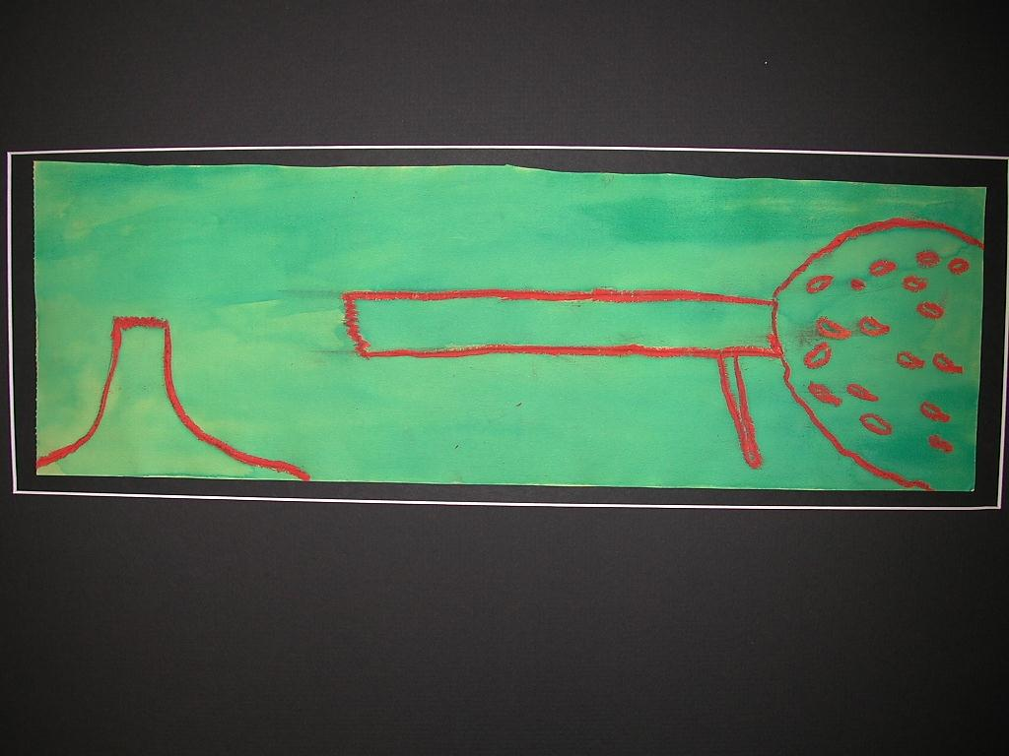
Playgrounds lay ruined

Slide 6
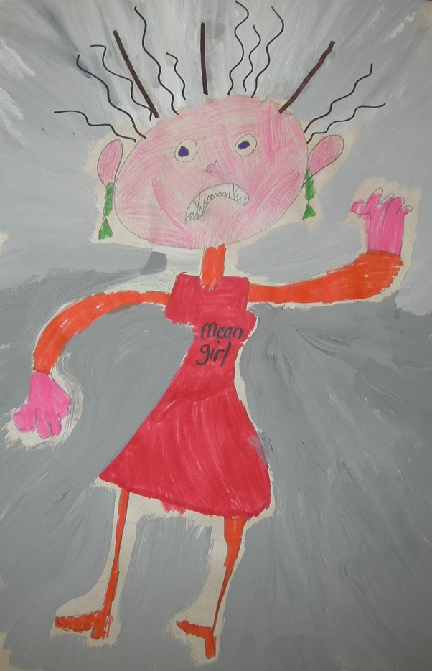
Katrina is evil, the children thought

Slide 7
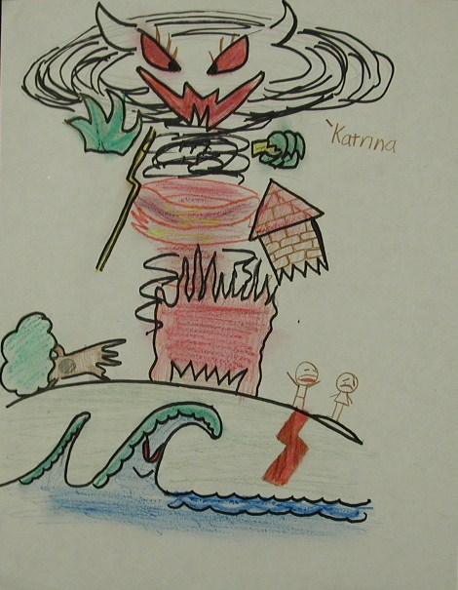
How can nature be so cruel, they wondered

Slide 8
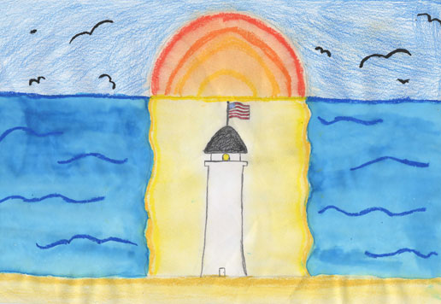
But soon they shifted to response-oriented thinking

Slide 9
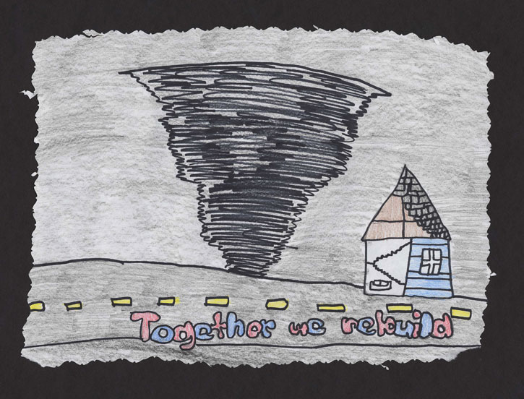
And a strictly forward focus

Slide 10
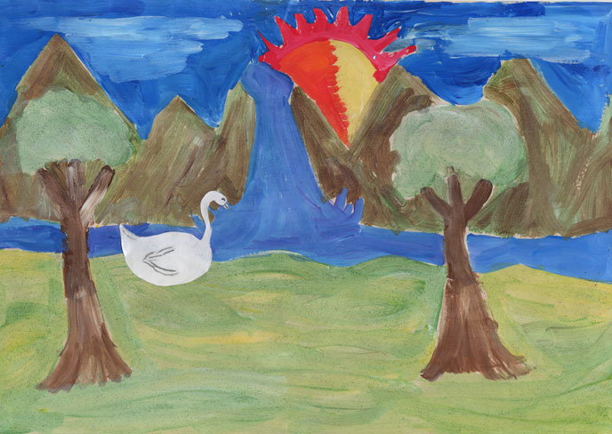
They refused to feel deflated or victimized

Slide 11
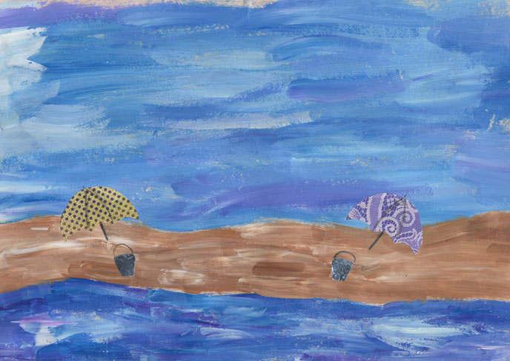
They began specifying, visualizing, collaborating

Slide 12
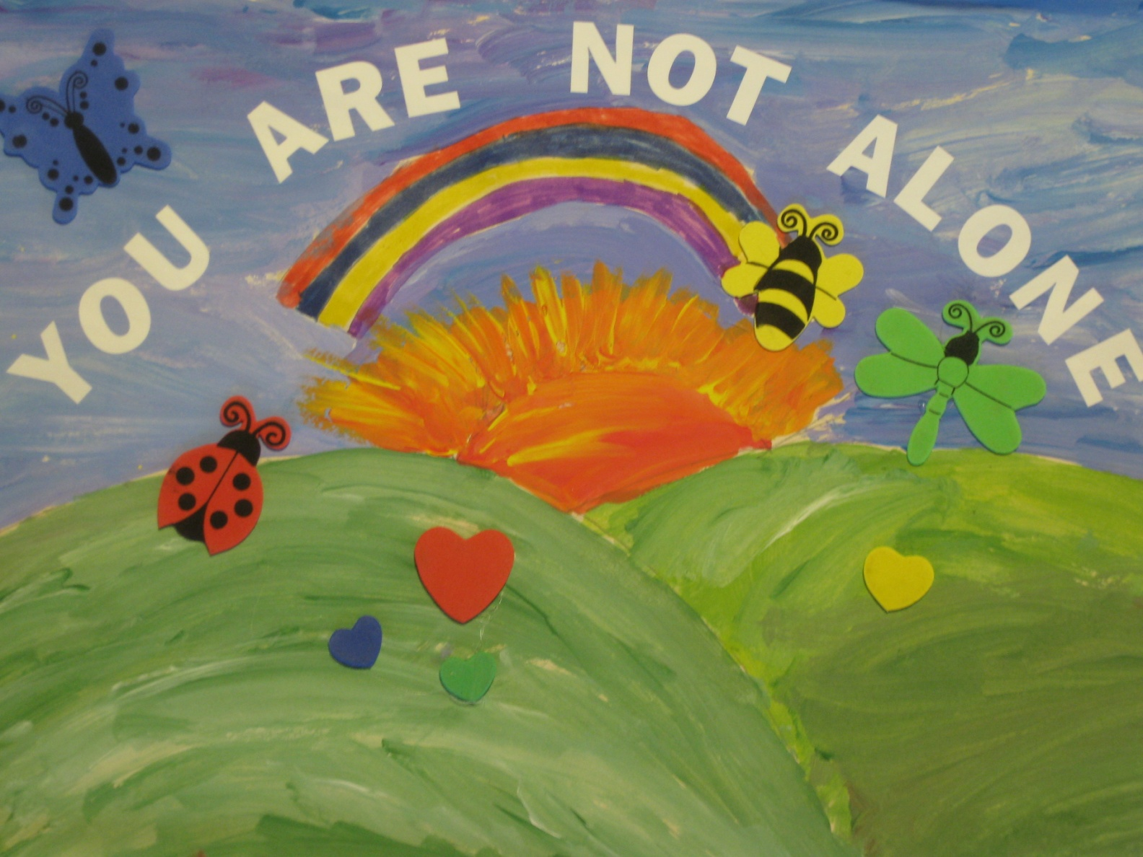
They gave hope to each other

Slide 13
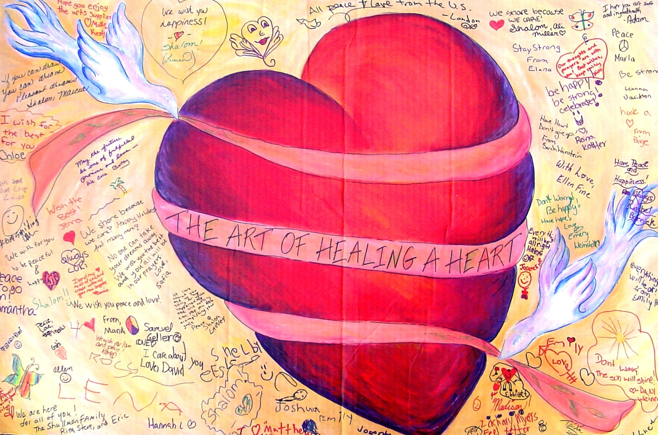
And others gave them hope

Slide 14
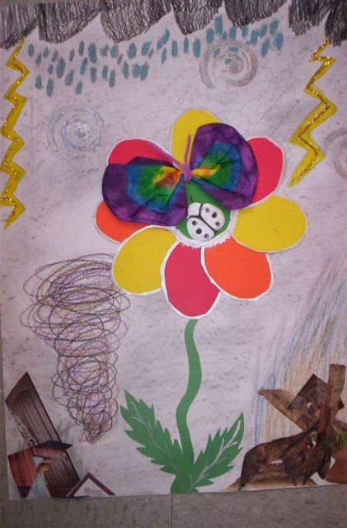
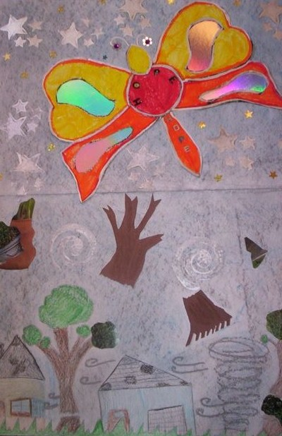
To turn a negative experience into a productive one

Slide 15
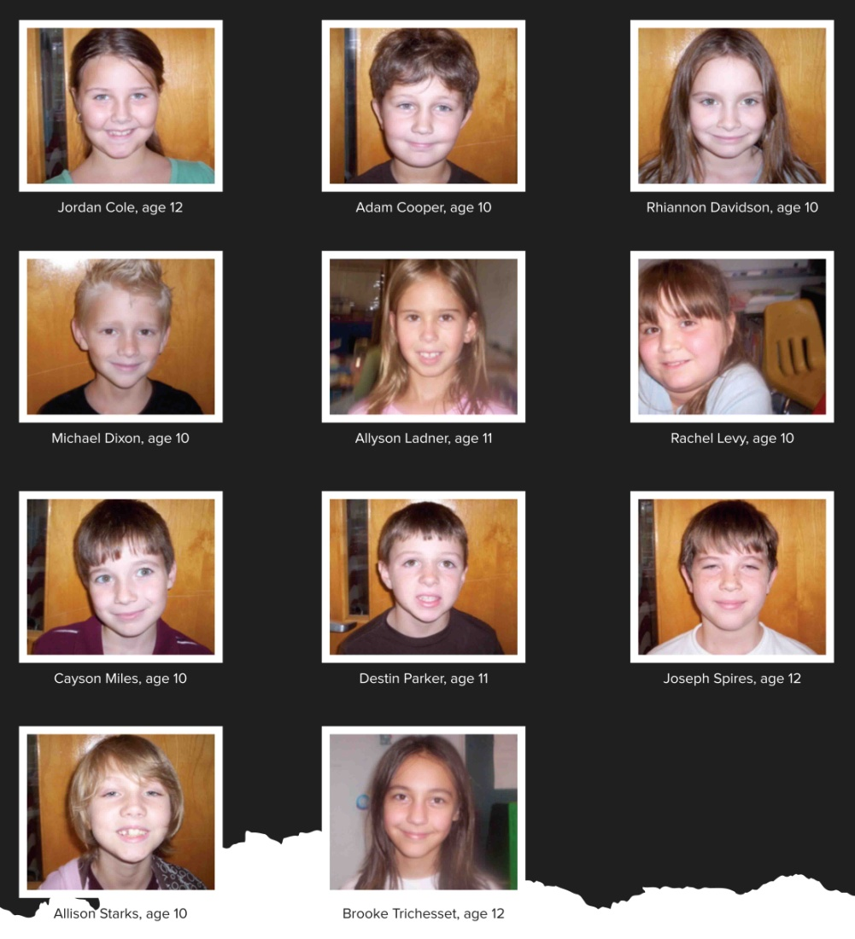
This is the story and art of these children of Katrina

Slide 16
Adapted from:
Katrina Healing Arts Program of the International Child Art Foundation
&
Joshua D. Margolis and Paul G. Stoltz, “How to Bounce Back from Adversity.”
Harvard Business Review, January-February 2010
The International Child Art Foundation:
Cultivates children’s imagination and creative critical thinking (the Arts Olympiad)
Restores trust in humanity of children living in conflict zones (Peace through Art Program)
Revives faith in nature of victims of natural disasters (Healing Art Program)
Fosters schoolchildren’s creativity through its publications (ChildArt quarterly magazine)
Produces an intervention to infuse creativity with empathy (World Children’s Festival)
https://ICAF.org/

